Slide 1
Unit 1: Intro to Hydrosphere Notes
In this unit you will learn to understand the hydrosphere and the impact of humans on local systems, and the effects of the hydrosphere on humans.
An Introduction to Water

Slide 2
What makes water unique?
1. Water is one of the most common substances on Earth.
2. It is the only substance that occurs as a solid, liquid, and gas
3. Water is known as the “universal solvent” because so many substances dissolve in water
-Because water is the universal solvent, it is rarely found “pure” on Earth.

Slide 3
Water’s Unique Properties
Polarity
Cohesion
Adhesion
High Surface Tension
Density
High Specific Heat
High Heat of Vaporization

Slide 4
Polarity
The Oxygen atom in water pulls two electrons away from the hydrogen atoms
The water molecule has a positive and negative end
Polar solutions mix with polar solutions.
Nonpolar solutions mix with nonpolar solutions.
Water(Polar)+Oil(Nonpolar)=Doesn’t Mix

Slide 5
Cohesion
The attractive force that holds molecules together.
Strongest in solids
Weakest in gases
Allows liquids to form droplets and gases to form clouds.

Slide 6
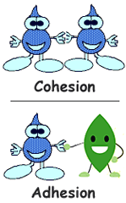
Adhesion
The property of water that allows it to overcome the force of gravity by sticking to other objects.
Examples:
Water on a mirror
Dew on the Grass in the morning

Slide 7
Surface Tension
Property of liquids that allows their surfaces to behave as if they were covered by a thin, elastic film.
Water: To Stick or Not to Stick

Slide 8
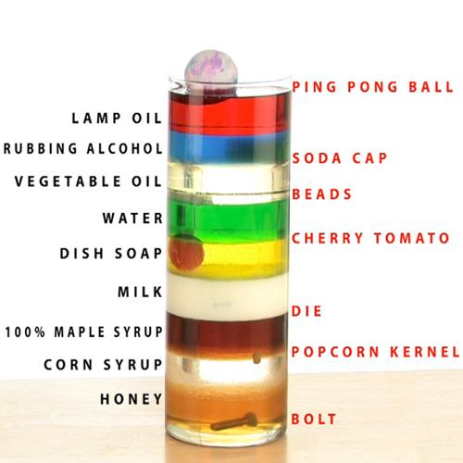
Density
The density of pure water is 1.0g/mL
If a substance has a density less than 1.0g/mL it will float.
If a substance has a density greater than 1.0g/mL it will sink.

Slide 9
Specific Heat
The amount of energy required to raise the temperature of matter.
Water has a very high specific heat.
Bottle Burn Experiment

Slide 10
Water on Earth
Covers 71% of the Earth’s surface
Hydrosphere: the portion of the Earth that contains water
Very little water is available to supply living organisms with what they need to survive.
97% of that water is not drinkable (saltwater, oceans)
3% is freshwater
Of the 3% that is fresh water
70% is frozen
In ice on land and in oceans
30% is free flowing
In rivers, lakes
Underground
In atmosphere
In plants and animals

Slide 11
The Water Cycle
The continuous movement of water in and around the earth.
Sun drives the water cycle
Evaporation
Condensation
Precipitation
Collection
All water eventually flows to the oceans
The Water Cycle by Bill Nye

Slide 12
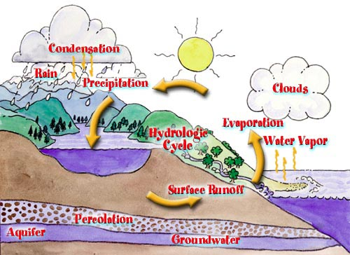

Slide 13
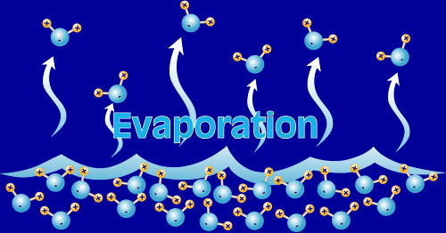
Evaporation
The process in which water changes from a liquid to a gas (water vapor)

Slide 14
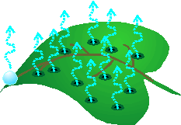
Water can also evaporate into the air directly from plants and trees
As they photosynthesize, they give off water vapor
Transpiration is the process by which water evaporates from plants into the atmosphere
Transpiration is like plants sweating

Slide 15
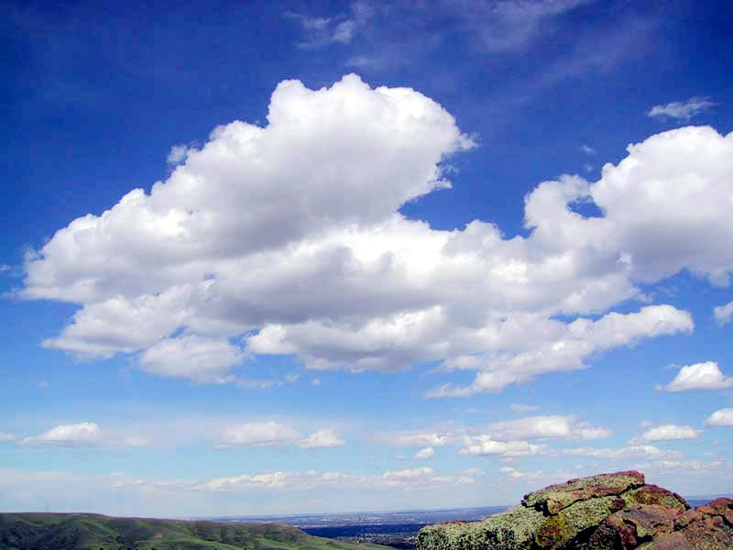
Condensation
The process by which water condenses to form clouds.
Magic School Bus: Water Changes

Slide 16
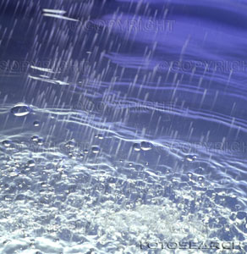
Precipitation
The water that falls from clouds.
Can be in the form of rain, sleet, snow, or hail.
How does precipitation form?

Slide 17
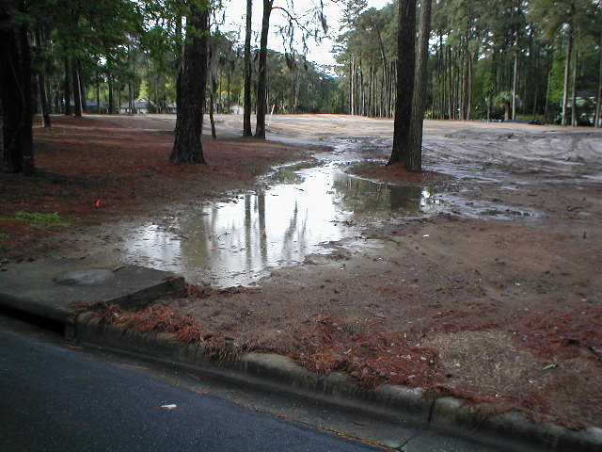
Precipitation Continued
Runoff
Precipitation that flows over land into streams and rivers.
Eventually flows back out into oceans.

Slide 18
What is Water Collection?
Surface Water: Rivers, Streams, Lakes, Ponds, Puddles, Oceans, Runoff
Groundwater: The water found in cracks and pores in sand, gravel and rocks below the earth’s surface

Slide 19
What is a river basin?
Portion of land drained by a river and its tributaries
Tributary- small stream or river that flows into a main river or lake
Sends all water falling from streams and creeks to a central river and out to sea
Final destination: estuary or ocean
Estuary-area where freshwater from the river meets salt water from the ocean

Slide 20
River Basins vs. Watersheds
Every single living land dweller lives in a river basin. All water drains towards the ocean due to gravity.
Larger river basins are made up of many interconnected watersheds
Example: Cape Fear and Neuse River Basins are made of many small watersheds
Watershed: areas of land around a smaller river, stream, or lake
Water runs to the lowest point- a river, stream, lake, or ocean

Slide 22
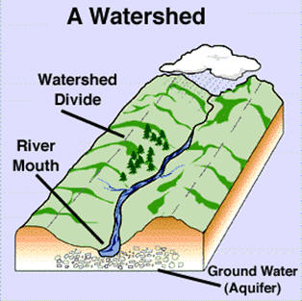
What is a divide?
A ridge (or high land) from which water flows in different directions
Ridge of a mountain range
Line of highest ground
Drainage basin- area into which all of the water on one side of a divide flows
All rivers, streams, and lakes are in a drainage basin

Slide 23
What river basin do we live in?
Everyone lives in a river basin
Our actions affect water quality and quantity downstream
17 river basins in NC
Feeds nations largest and most productive coastal estuaries
MPMS is in the Cape Fear River Basin.
East of 55: Neuse River Basin

Slide 24
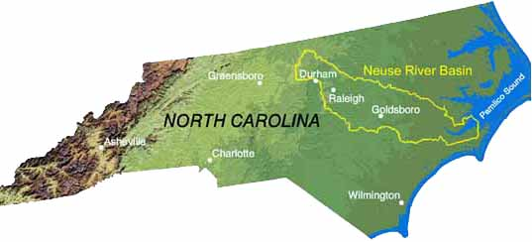

Slide 25
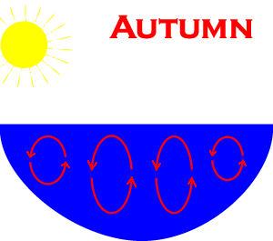
Ponds and Lakes
Naturally form where water collects
Lake Turnover
Lake water is not still
It is not all the same temperature
Eutrophication
An increase in the nutrients in a lake or pond
Most lakes eventually fill in and become meadows
Slow process

Slide 26
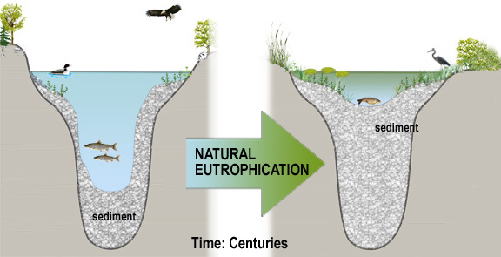
Natural Eutrophication

Slide 27
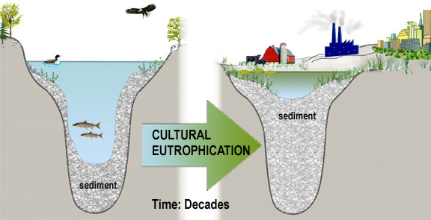
Cultural Eutrophication

Slide 28
Groundwater
Groundwater
Water held underground. Can be permeable or impermeable:
Permeable
If a substance is permeable, liquids can flow through it
Impermeable
Liquids cannot flow
Porosity: a measure of how much of a rock is open space. This space can be between grains or within cracks or cavities of the rock.

Slide 29
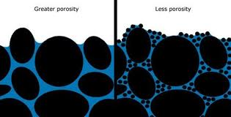
Porosity

Slide 30
Permeable or Impermeable?
Rain Jacket
Umbrella
Cotton Shirt
Water Filter
Drinking Glass
Plastic
Screen Door

Slide 31
Groundwater
How does groundwater get there?
Infiltration
Water that seeps into rocks and between particles of soil
Percolation
The downward movement of water through pores and other spaces due to gravity

Slide 32
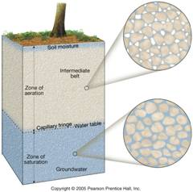
Groundwater
Water Table
The top of the region that is saturated or completely filled with water
The region below the water table is called the saturated zone.

Slide 33
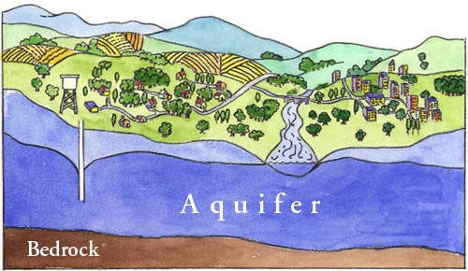
Groundwater
Aquifer
An aquifer is an underground layer of permeable rock or sediment that contains water
Permeable material to hold water
Neighboring area of impermeable material to keep the water from draining
A source of water to replenish/refill

Slide 34
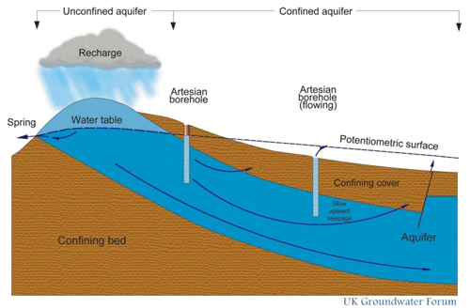

Slide 35
Aquifers
We can collect water from aquifers
Springs
A spring is a flow of water from the ground at a place where the surface of the land dips below the water table
Wells
A well is a hole in the ground that reaches down to the saturation zone
Water can then be pumped out

Slide 36
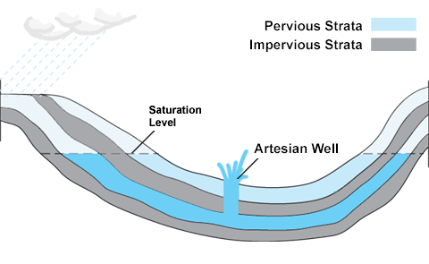
Artesian Wells
Do not need a pump
Water flows to the surface naturally due to the pressure it is under

Slide 37
Why is the ocean salty?
Dissolved chemicals eroded from the earth’s crust and washed into the sea
Solid and gaseous ejections from volcanoes
Particles swept from the land by winds
Materials dissolved from sediments deposited on the ocean floor
Salinity changes
Increased by evaporation and freezing
Decreased by rainfall, runoff, or melting ice

Slide 38
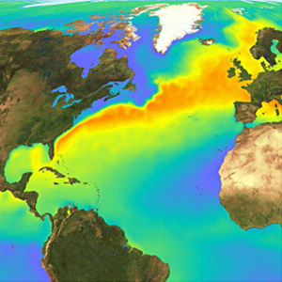
How do oceans affect the climate?
Heat energy is stored in oceans
Summer: heat energy is absorbed
Winter: heat energy is released
Most noticeable near the equator, less near the poles
Coastal vs. Mountain

Slide 39
Vocabulary: Check to make sure this is all included in your notes somewhere!
Groundwater Water: that is found beneath the Earth's surface, between soil or rock particles.
Hydrosphere: all the water on Earth
Ocean Basin: area covered by ocean water
River Basin/ Watershed: the drainage area of a river
Surface Water: Water found above ground that moves into river basins.
Water Cycle: The cycle through which water moves around the Earth, changing both its phase (between solid to liquid to gas) and its location (in the oceans, in clouds, in streams and lakes, and in groundwater).

