Slide 1
Physical and Chemical Properties Physical and Chemical Change Chemical Equations and Reactions Notes

Slide 2
Physical Properties
Physical properties can be observed and measured without changing the kind of matter being studied.
Examples:
Melting point
Boiling point
Density
Color

Slide 3
Chemical Properties
Chemical Properties can be recognized only when substances react or do not react chemically with on another; when they undergo a change in composition
Examples:
Reacting with Oxygen
Flammability
Rusting
Reacting with Acids
Metals react to form compounds
Bases react to form water and neutralize

Slide 4
What is a physical change?
The chemical composition of the substance does not change
Changes in size, shape, or state of matter
Example:
Tearing paper
Boiling Water
Freezing Kool-aid

Slide 5
What is a chemical change?
A change in which a new/different substance is formed
Examples: Burning Paper Digesting Food
Indicators of chemical change: Creation of light Creation of heat or temperature change Creation of a gas Color Change Formation of a precipitate

Slide 7
Physical or Chemical Change?
Tearing paper
Melting ice
Digesting food
Rusting bicycle
Chopping Wood
Baking a cake
Making salt water
Burning wood

Slide 8
Wrap Up Video (Physical and Chemical Change)
http://www.youtube.com/watch?v=C4pQQQNwy30

Slide 9
What is the Law of Conservation of Mass?
Regardless of how substances are changed, the total mass (or amount of matter) remains the same
http://www.youtube.com/watch?v=geoQ2qJGGJs

Slide 10
What is a chemical formula?
A molecule of a compound is represented by a chemical formula
Each element is represented by the symbol
The number of each type of element is represented by a subscript

Slide 11
C₆H₁₂O₆
Element Symbol
Subscript

Slide 13
What is a chemical equation??
A chemical equation represents the changes that take place in a chemical reaction

Slide 14
Reactants
Products
2H₂O₂ 2H₂0 +O₂
Coefficient: Multiply by subscript to calculate number of atoms

Slide 15
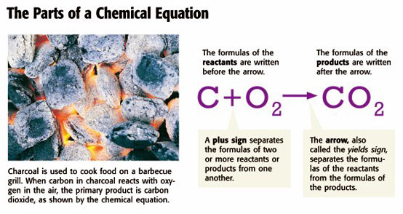
Reactants: Written before the arrow
Products: Written after the arrow

Slide 16
Evidence of a Chemical Reaction
A precipitate is a solid that forms when two liquids react with each other.
The precipitate is a product of the chemical reaction
Liquid + liquid → solid

Slide 17
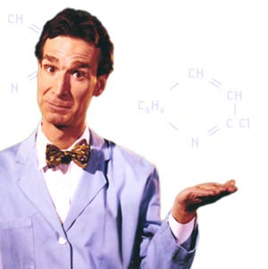
Bill Nye- Simple Chemical Reactions
http://www.youtube.com/watch?v=4lBFVd1yx3U

